Slide 1
North York Neighborhoods Final Project

Slide 2
Introduction
A Retail company is opening a new store in North York Borough. In order to do that the company is studying different neighborhood to open a new Supermarket store identifying similar localities based on the neighborhood where they already have a Store with good Sales records. In order to do that the Data Science area will use K Means clustering to identify clusters with similar (or dissimilar) localities. The Stakeholders are the Business Development Area, and they have to find the right place to build the New Store. This analysis can be extended to recommending localities to new and upcoming Supermarket. The analysis can also be extended to analyze the average spending for each locality's in terms of probable average spending, where would you be recommended to open it, and so on.

Slide 3
2. Data Description
The data we use has the following columns. Every Supermarket (or store). The collected Spatial data has been stored in the Comma Separated Value. Each Supermarket in the dataset is uniquely identified by its Supermarket Id. We will use Web Scraping for the neighborhood and the Foursquare API to find different Supermarket types of each neighborhood.

Slide 4
3. Methodology
In this section we will collect and prepare all the data, then we will analyse the data. Finally, we will use unsupervised machine learning technique (K means) to find similarity between neighborhood.
Web Scraping
We will use the Beautifulsoup librarie to web scrap the Wikipedia table with the different neighbords. After doing this request we will filter the neighbors with NaN values and not assigned values. Then we will load and merge a .csv file with the Latitud and Longitude of each neighborhood. Finally, we will filter the “North York” Borough
Forsquare API
After building the dataframe we will use the Forsquare API to obtain the different venue categories per neighbors. After that we will filter all the interesting venue types for this analysis like:

Slide 5
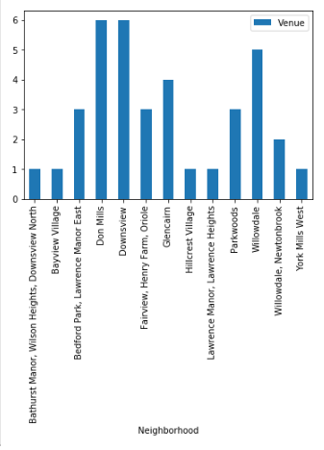
The amount of venue per neightbord

Slide 6
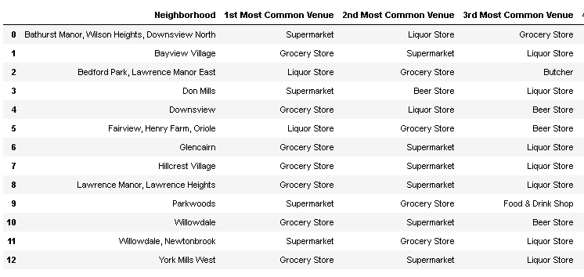
The most common Venue of each neighbord

Slide 7
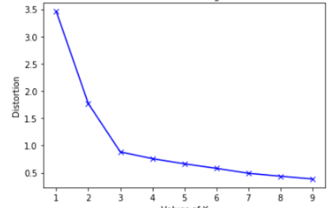
K-means Elbow

Slide 8
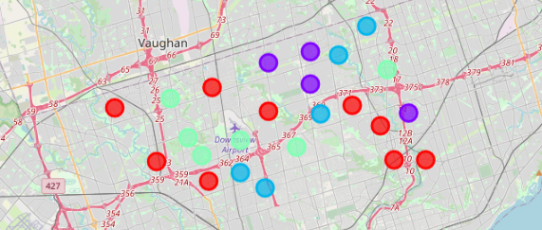
Map Plot

Slide 9
5. Discussion
As we can see in the Results chapter the average distance between data points and the centroid (Error) is decreasing,however, we should use 3 different Cluster according to the “Elbow Method”.
6. Conclusion
In this project we use Web scraping technique to obtain table for internet, we consume an API to obtain and build features to train an unsupervised machine learning method as K–means and find similarity between neighborhood using only information about the Supermarket store. We also optimize the number of cluster that we should use, with all this information we can evaluate which cluster is more similar and which location is optimal to open new Store.

